Slide 1
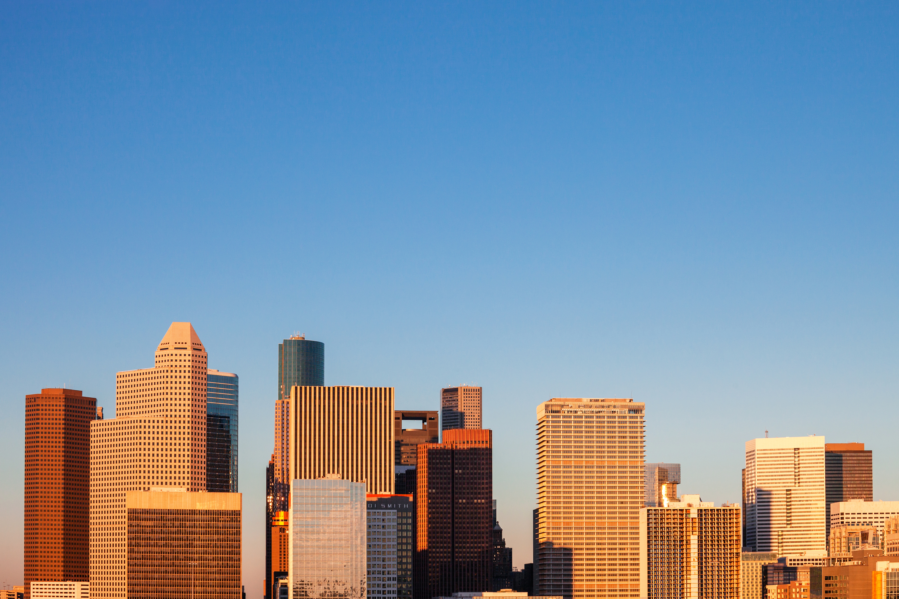




Hello! I am from Mexico

Slide 2


Nota
Se les pidió a los alumnos anticipadamente que tuvieran a la mano
1 hoja blanca
1 marcador o crayón negro
Vamos a pedirle a los chicos que corten su hoja en dos y hagan lo siguiente
Vamos a hacer un trabajo del verbo to be como se aprecia en el vídeo de la clase muestra, alumno por alumno.

Slide 3




Verb To Be
Hello!
I am Luis. Yo soy Luis.
Hola !

Slide 4
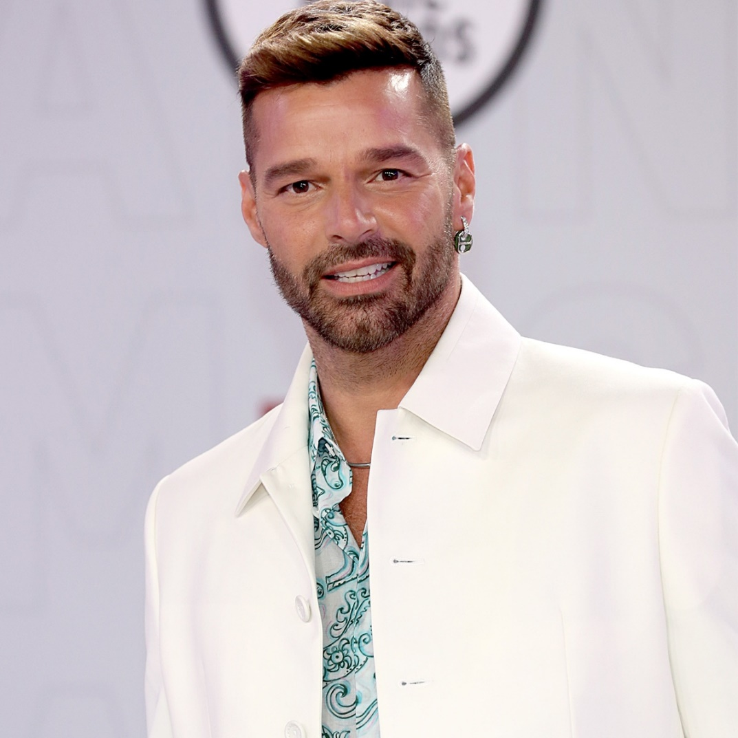
Verb To Be
He is ______
El es ____
RICKY

Slide 5
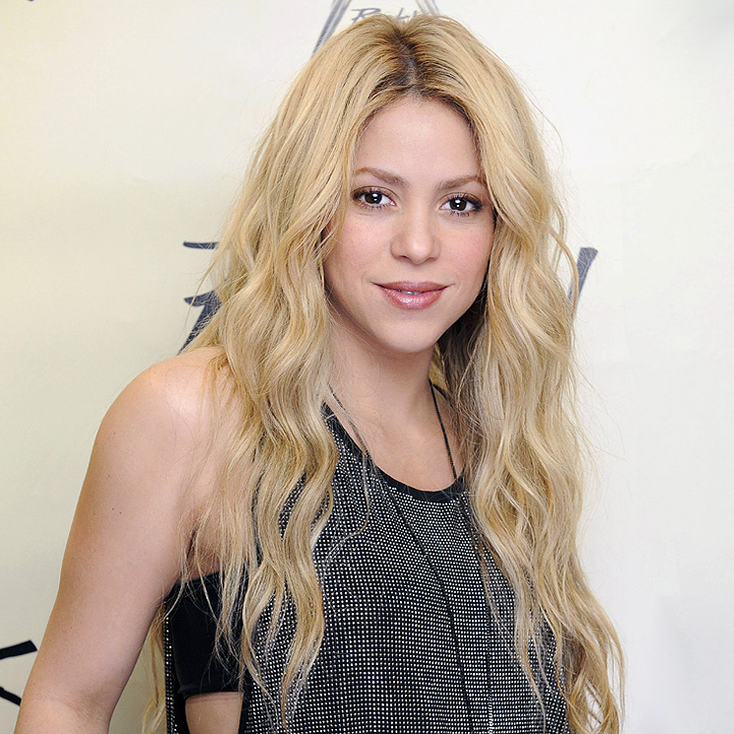
Verb To Be
She is ______
Ella es _____
SHAKIRA

Slide 6


Verb To Be
Hello!
I am _____
He is ______
She is ______

Slide 7
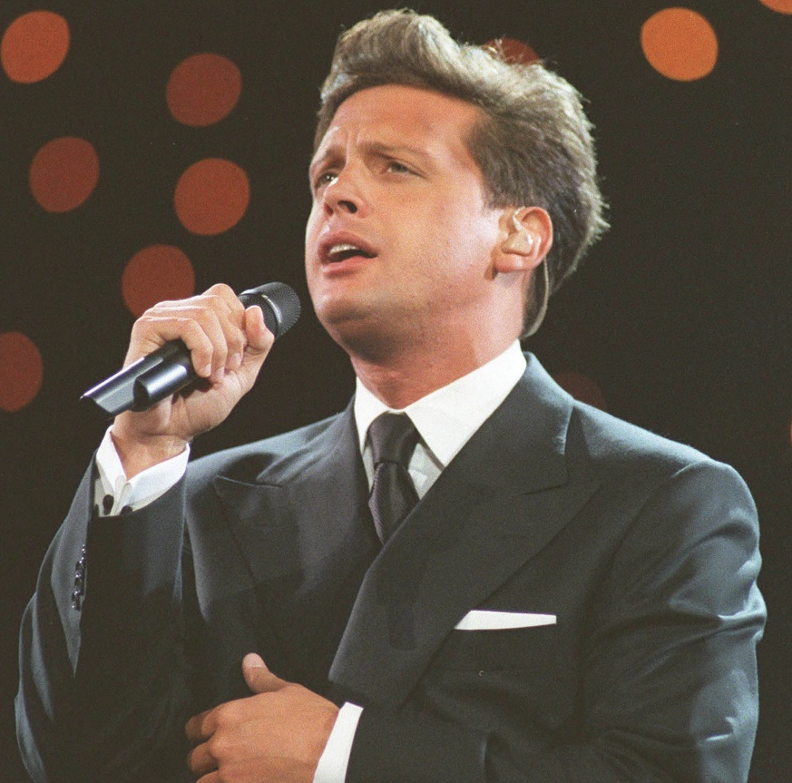
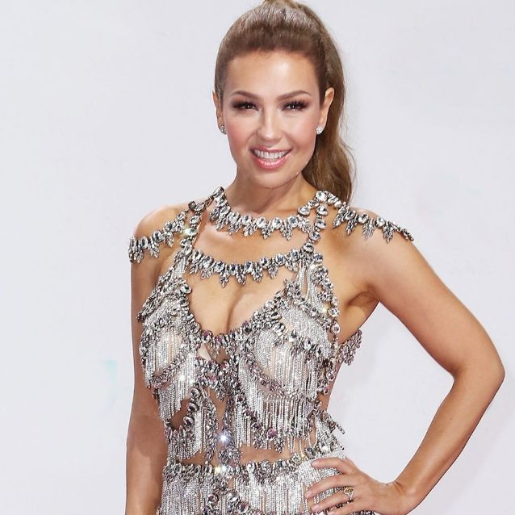
Verb To Be
LUIS MIGUEL
THALIA
They are ______ and ______.
Ellos son ____ y _____ .

Slide 8


Verb To Be
Hello!
I am _____
They are _____ and _____

Slide 9
Verb To Be
Hello!
We are Luismi, Thalia and Luis.

Slide 10
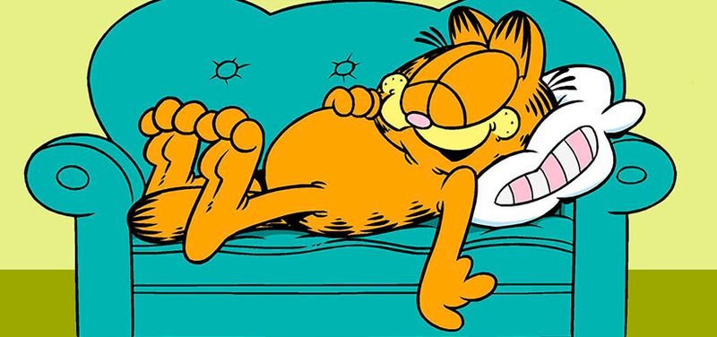

Verb To Be
It is ____
GARFIELD
They are ______ AND _____
GARFIELD AND ODIE

Slide 11
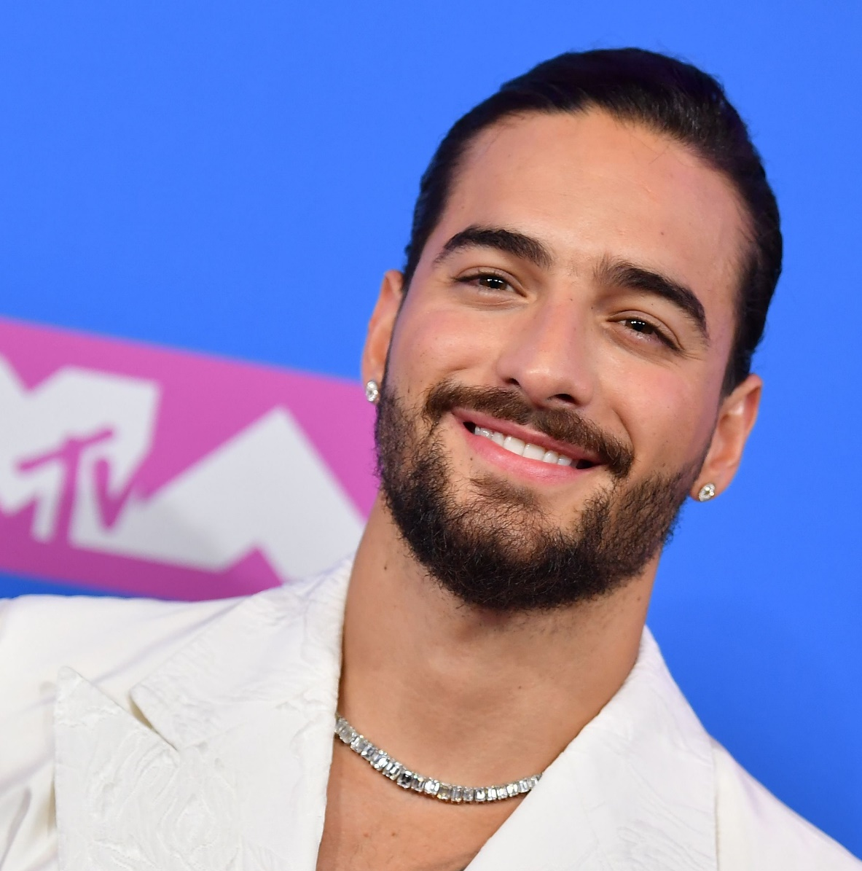
Verb To Be
MALUMA

Slide 12
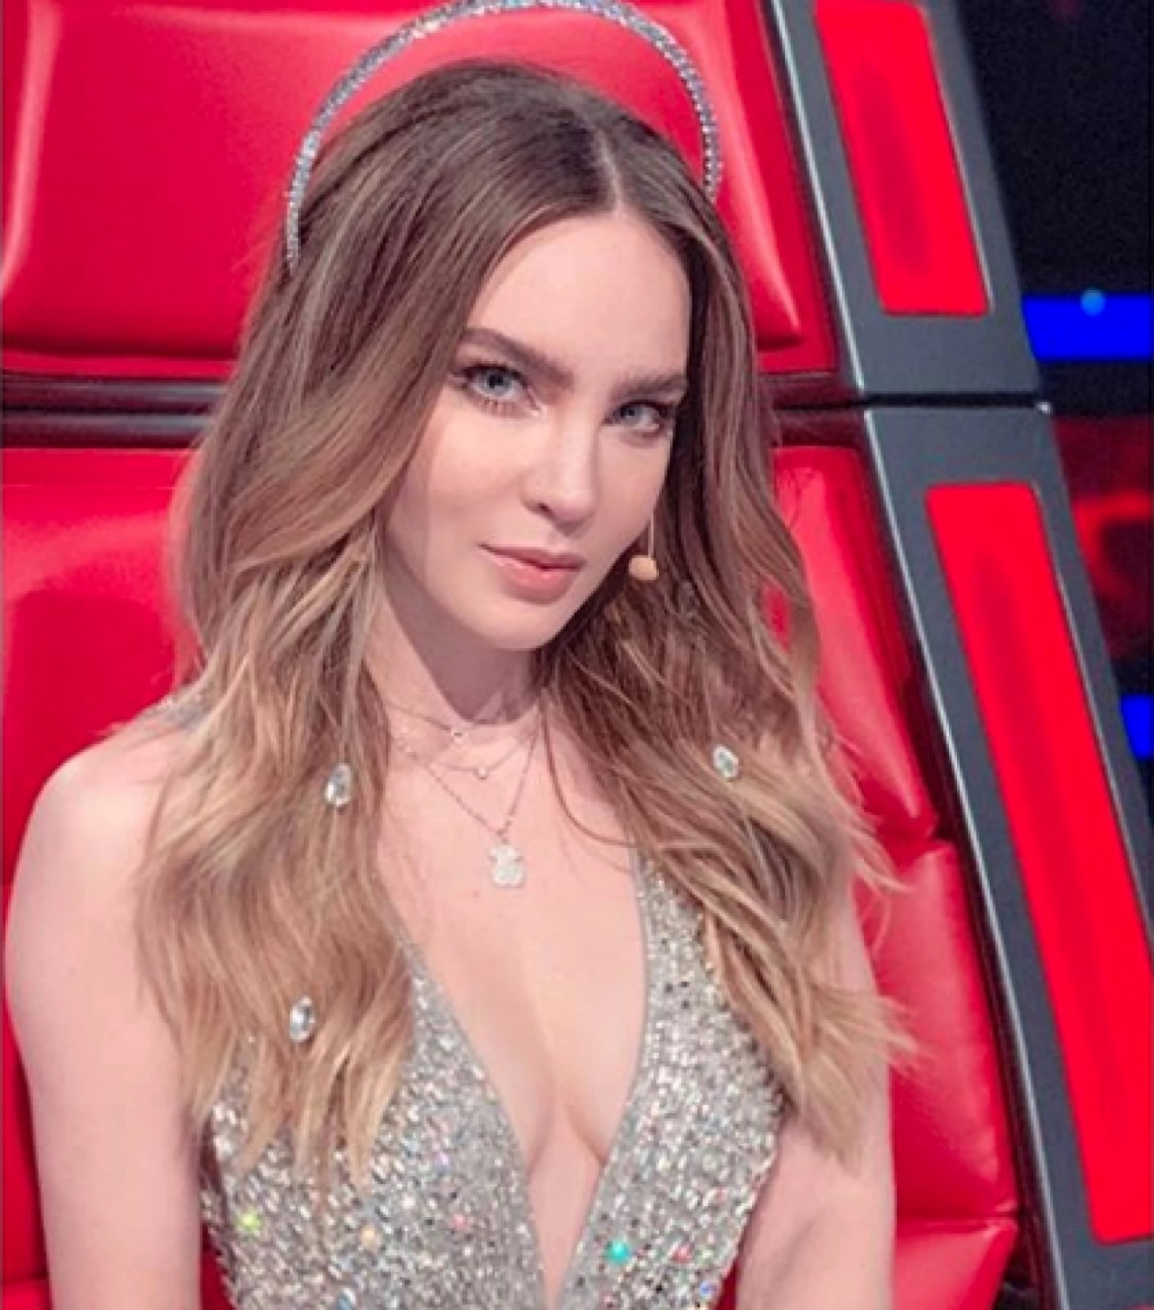
Verb To Be
BELINDA

Slide 13
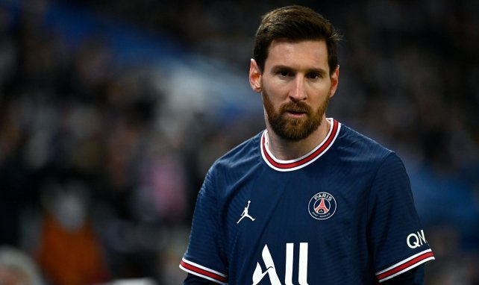

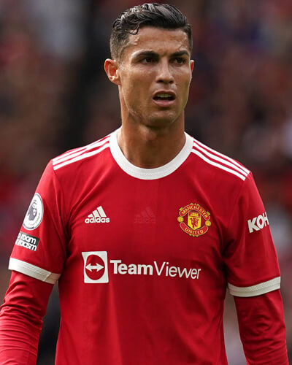
Verb To Be
CRISTIANO
MESSI

Slide 14
Verb To Be
I
YOU
WE
THEY
HE
SHE
IT
AM
ARE
IS
Chapter 1, lesson 5

Slide 15
Verb To Be
is
She ____ Sara.
Tom ____ my brother.
Sally and Peter _____ from Mexico.
Mice ______ horrible.
My brother ____ a doctor.
My sisters ______ teachers.
My dog ____ smart.
English Forever ____ the best school.
My father and my mom _______ at home.
We _____ in our English class.
is
are
are
is
are
is
is
are
are

Slide 16
Verb To Be
RICKY
SHAKIRA

Slide 17
Verb To Be
LUIS MIGUEL
THALIA

Slide 18
Verb To Be
CRISTIANO
MESSI

